Slide 1

Being in the shoes of an online buyer
Pedro, Felix Andrei IV
Teodoro, Emily Grace

Slide 2






Slide 3
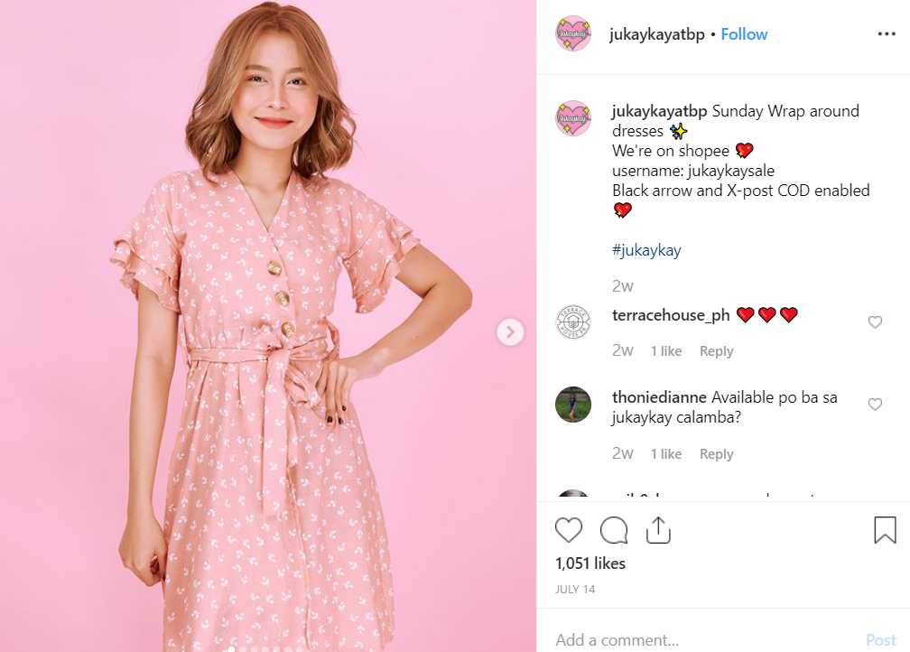



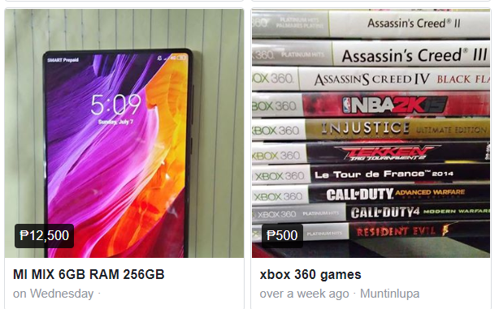

Slide 4
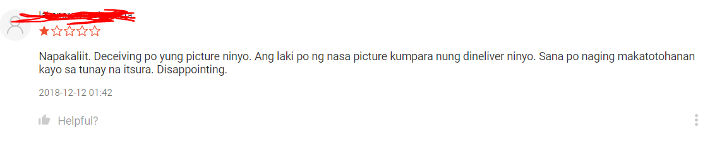
Observation
The items isn’t the same as the picture shown in the online shop.

Slide 5
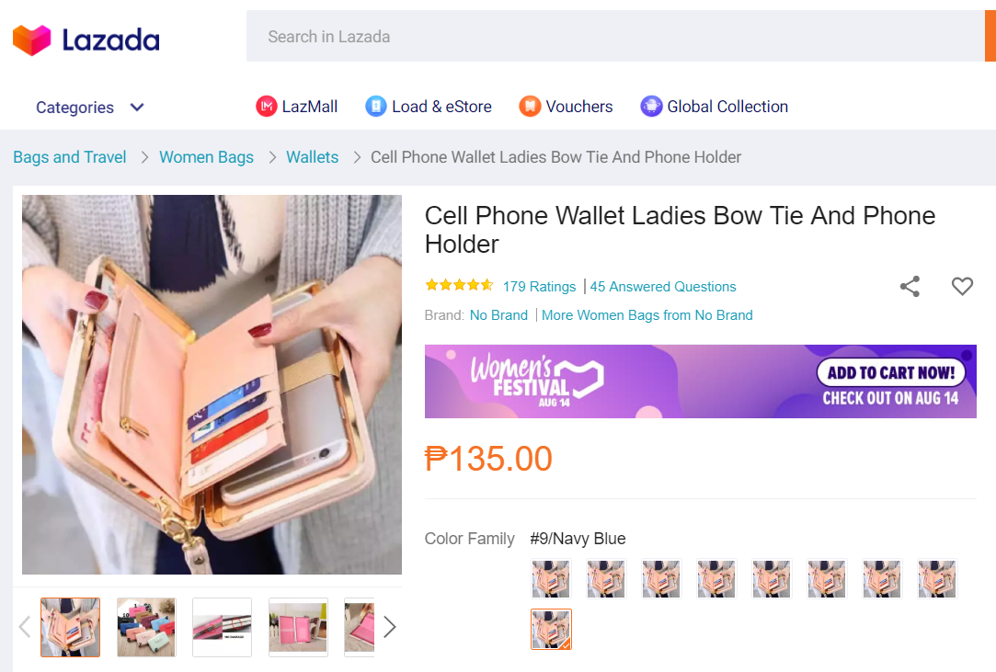
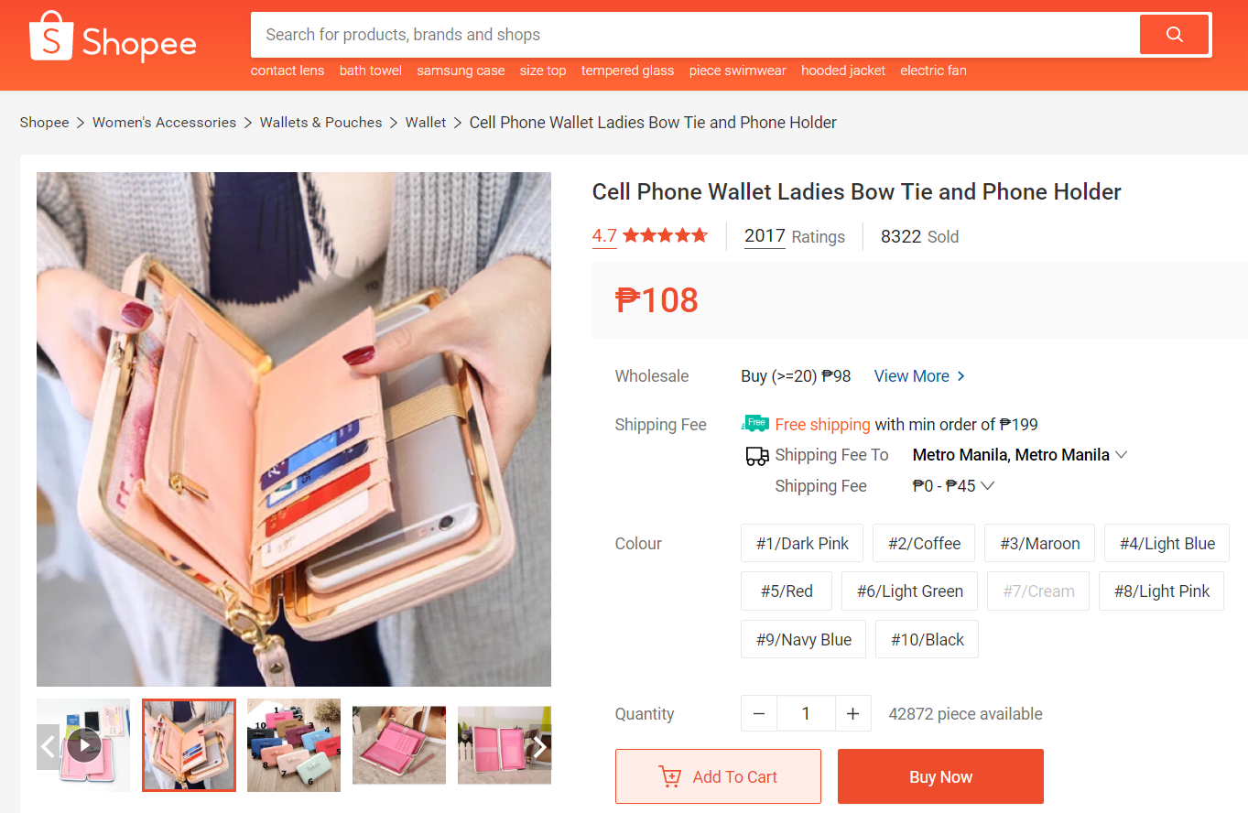
Observation
The buyer would like an app that would help compare prices.

Slide 6
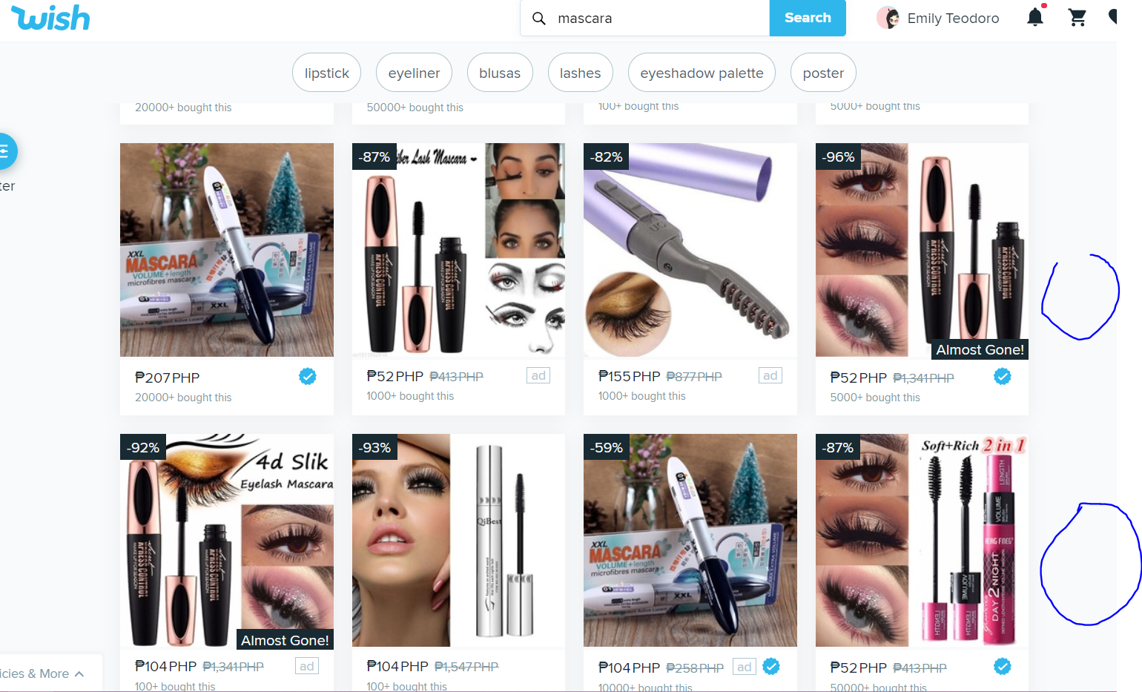
Observation
The items isn’t the same as the picture shown in the online shop.

Slide 7
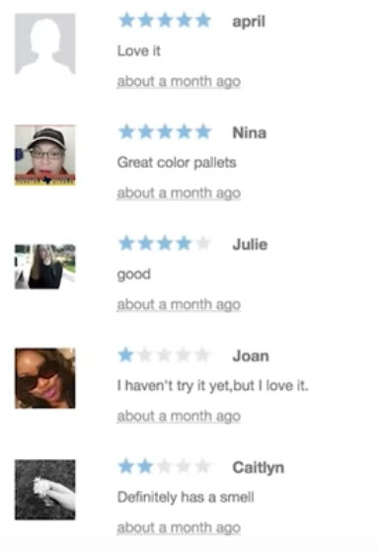
Observation
The reviews on the online shop is forged.

Slide 8
Identification Needs
The buyer needs an application that will be easy to compare prices.
The buyer needs application that will be easy to compare shipping fee.
The buyer needs application that will be easy to compare the online stores ratings and reviews.
The buyer needs a way to use vouchers as an option to save money.

Slide 9
Point of View
Need for better price comparison of online shops
The buyer needs an application to be able to easily compare prices between different online shops, so they won’t have too many saved or bookmark items.

Slide 10
Point of View
Need for better ratings management of online shops.
The buyer needs an application to be able to easily compare the rating management between different online shops, so they won’t have too many saved or bookmark online shops.

Slide 11
Point of View
Need for working and available vouchers
The buyer needs an application to be able to easily find vouchers that they can use that is available.

Slide 12
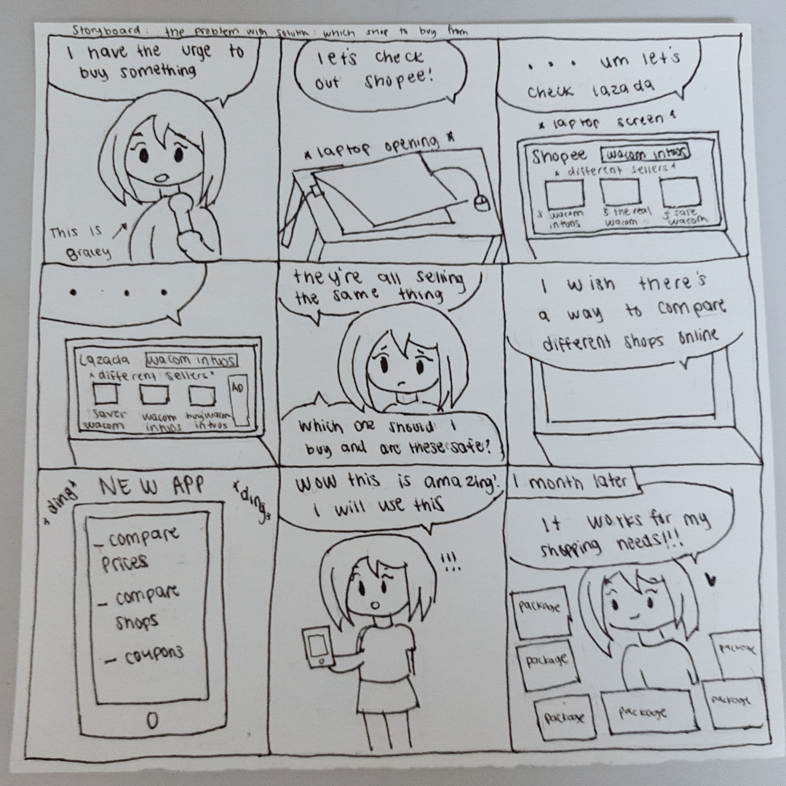
Storyboard 1

Slide 13
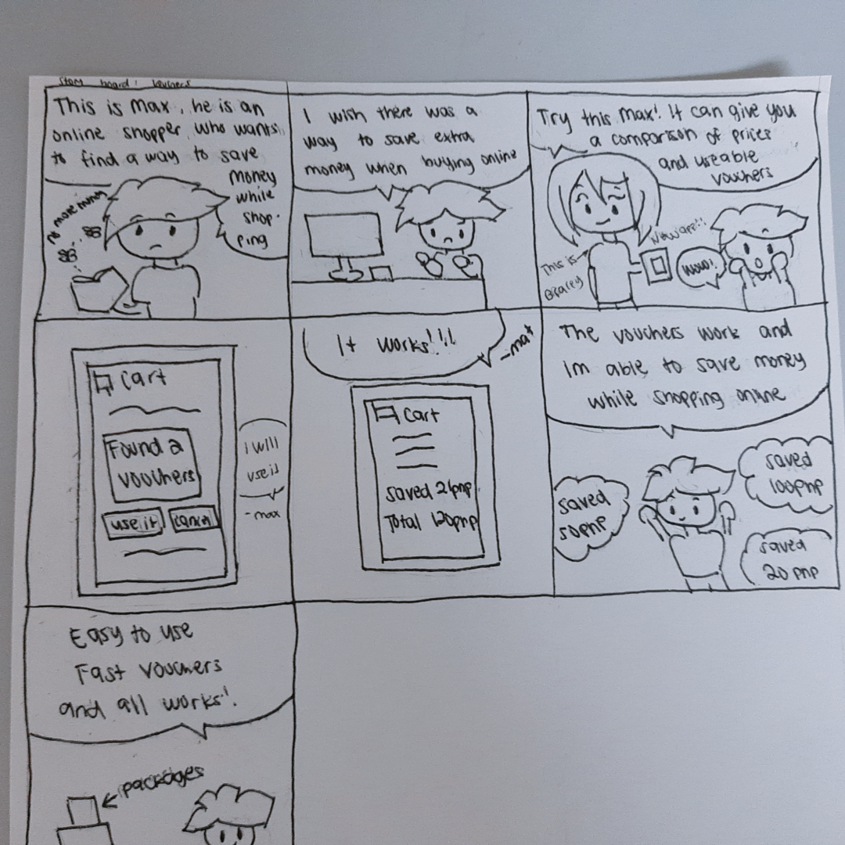
Storyboard 2

Slide 14
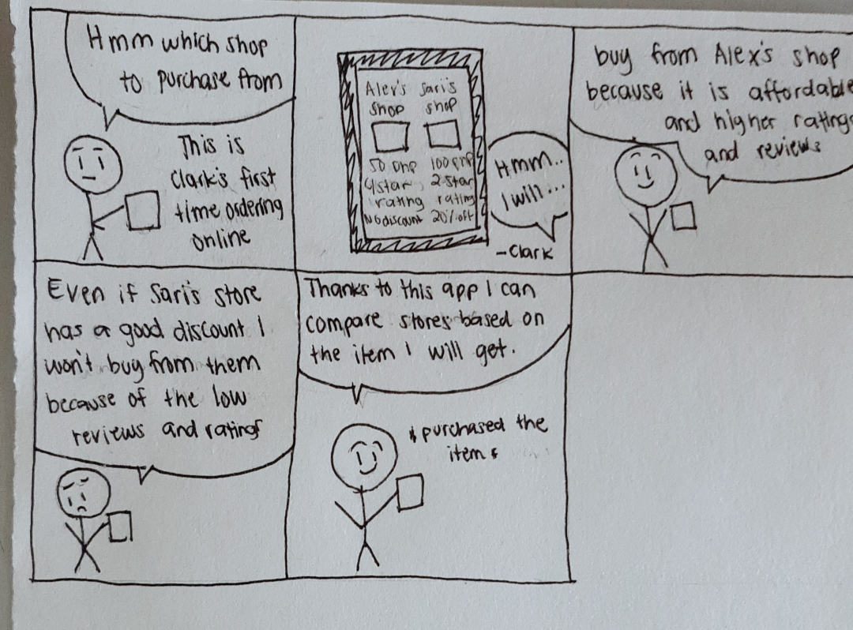
Storyboard 3

Slide 15
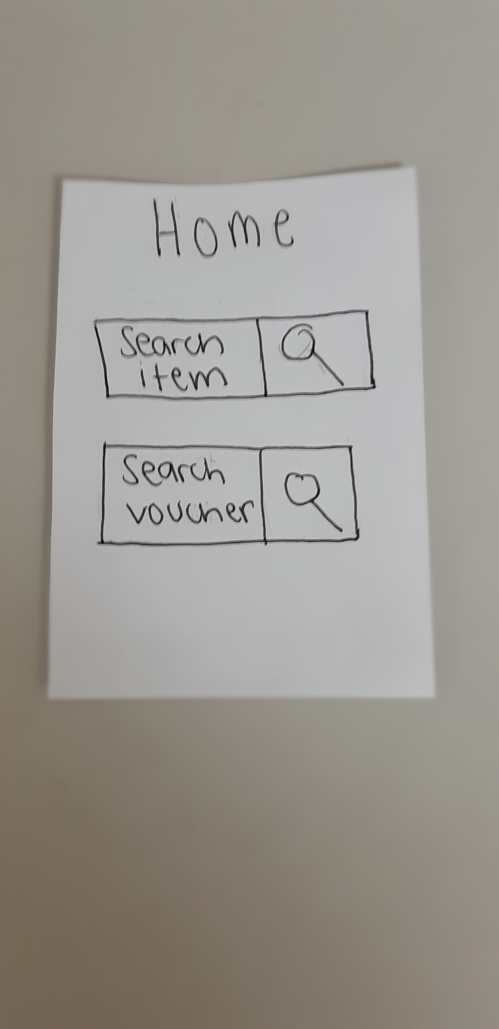
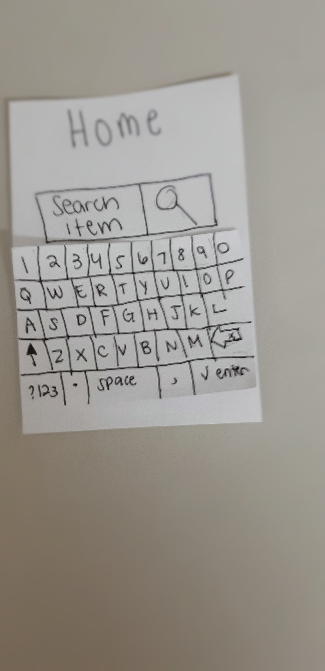
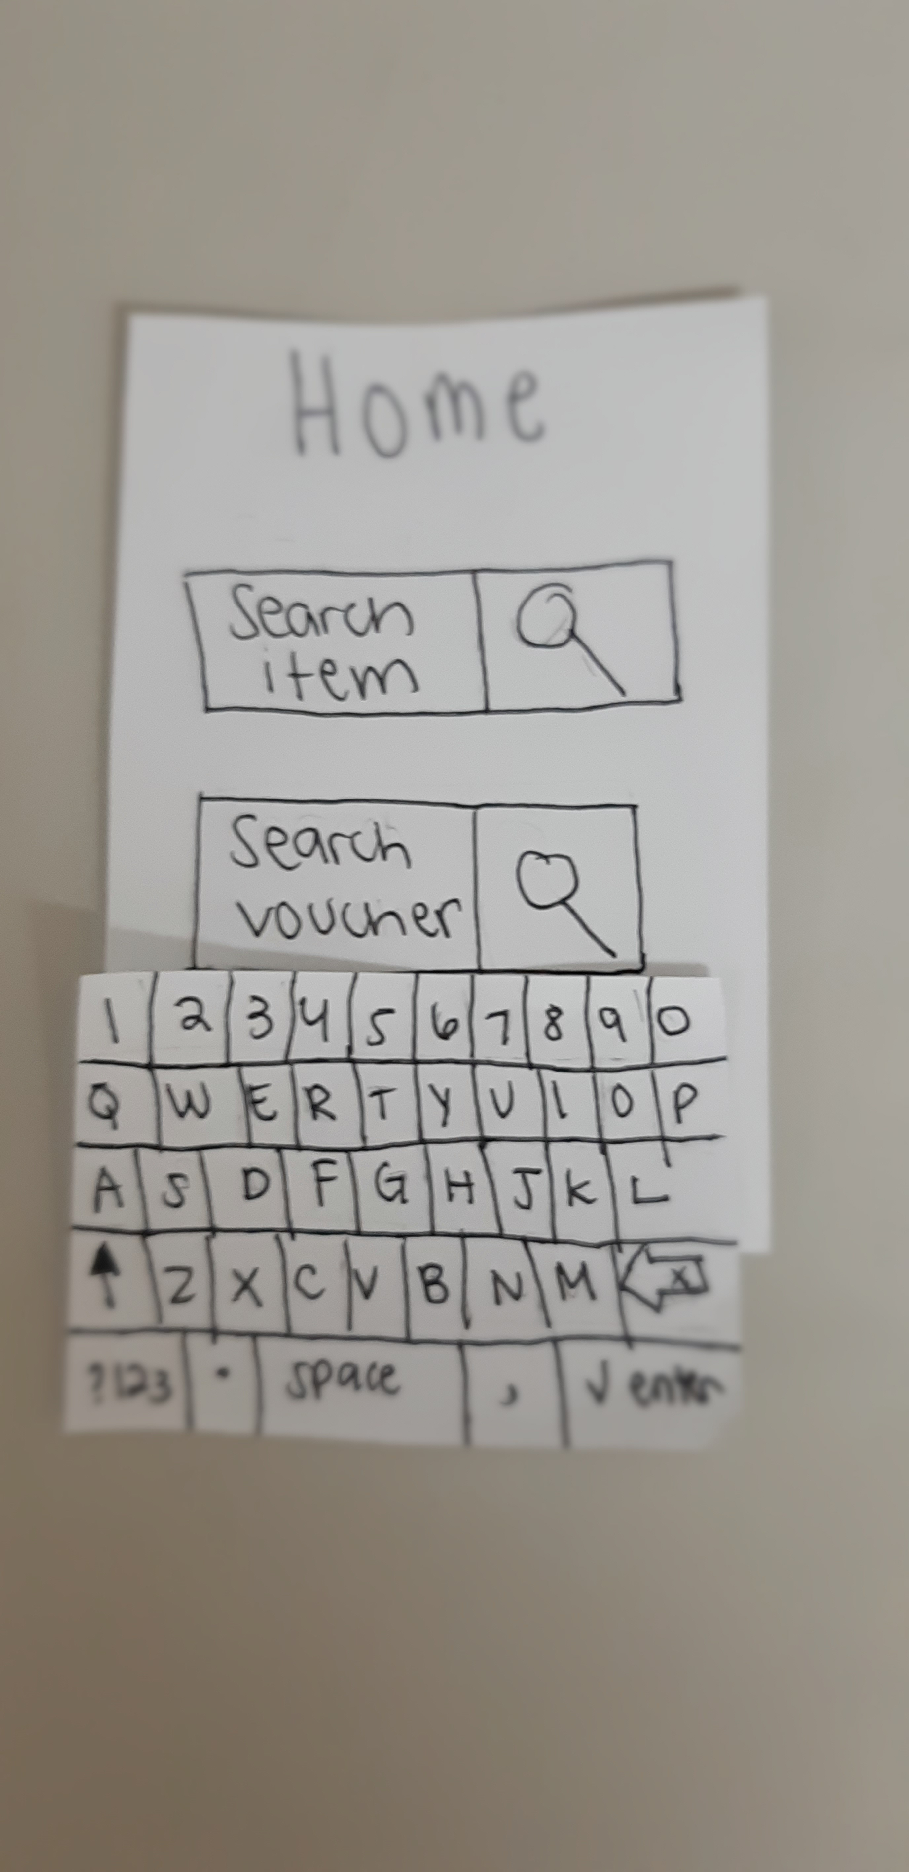
Paper Prototype 1

Slide 16
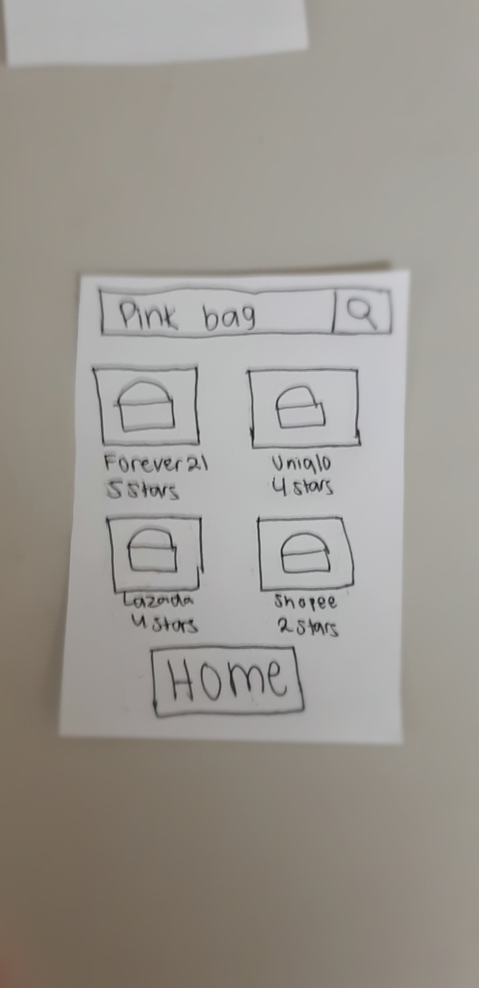
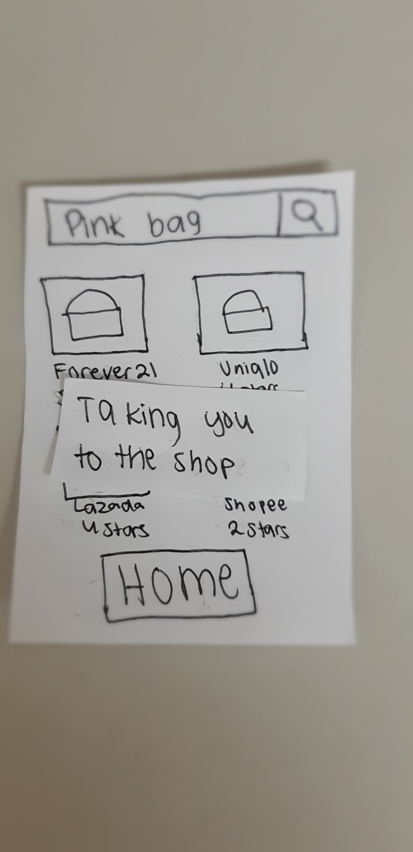
Paper Prototype 1

Slide 17
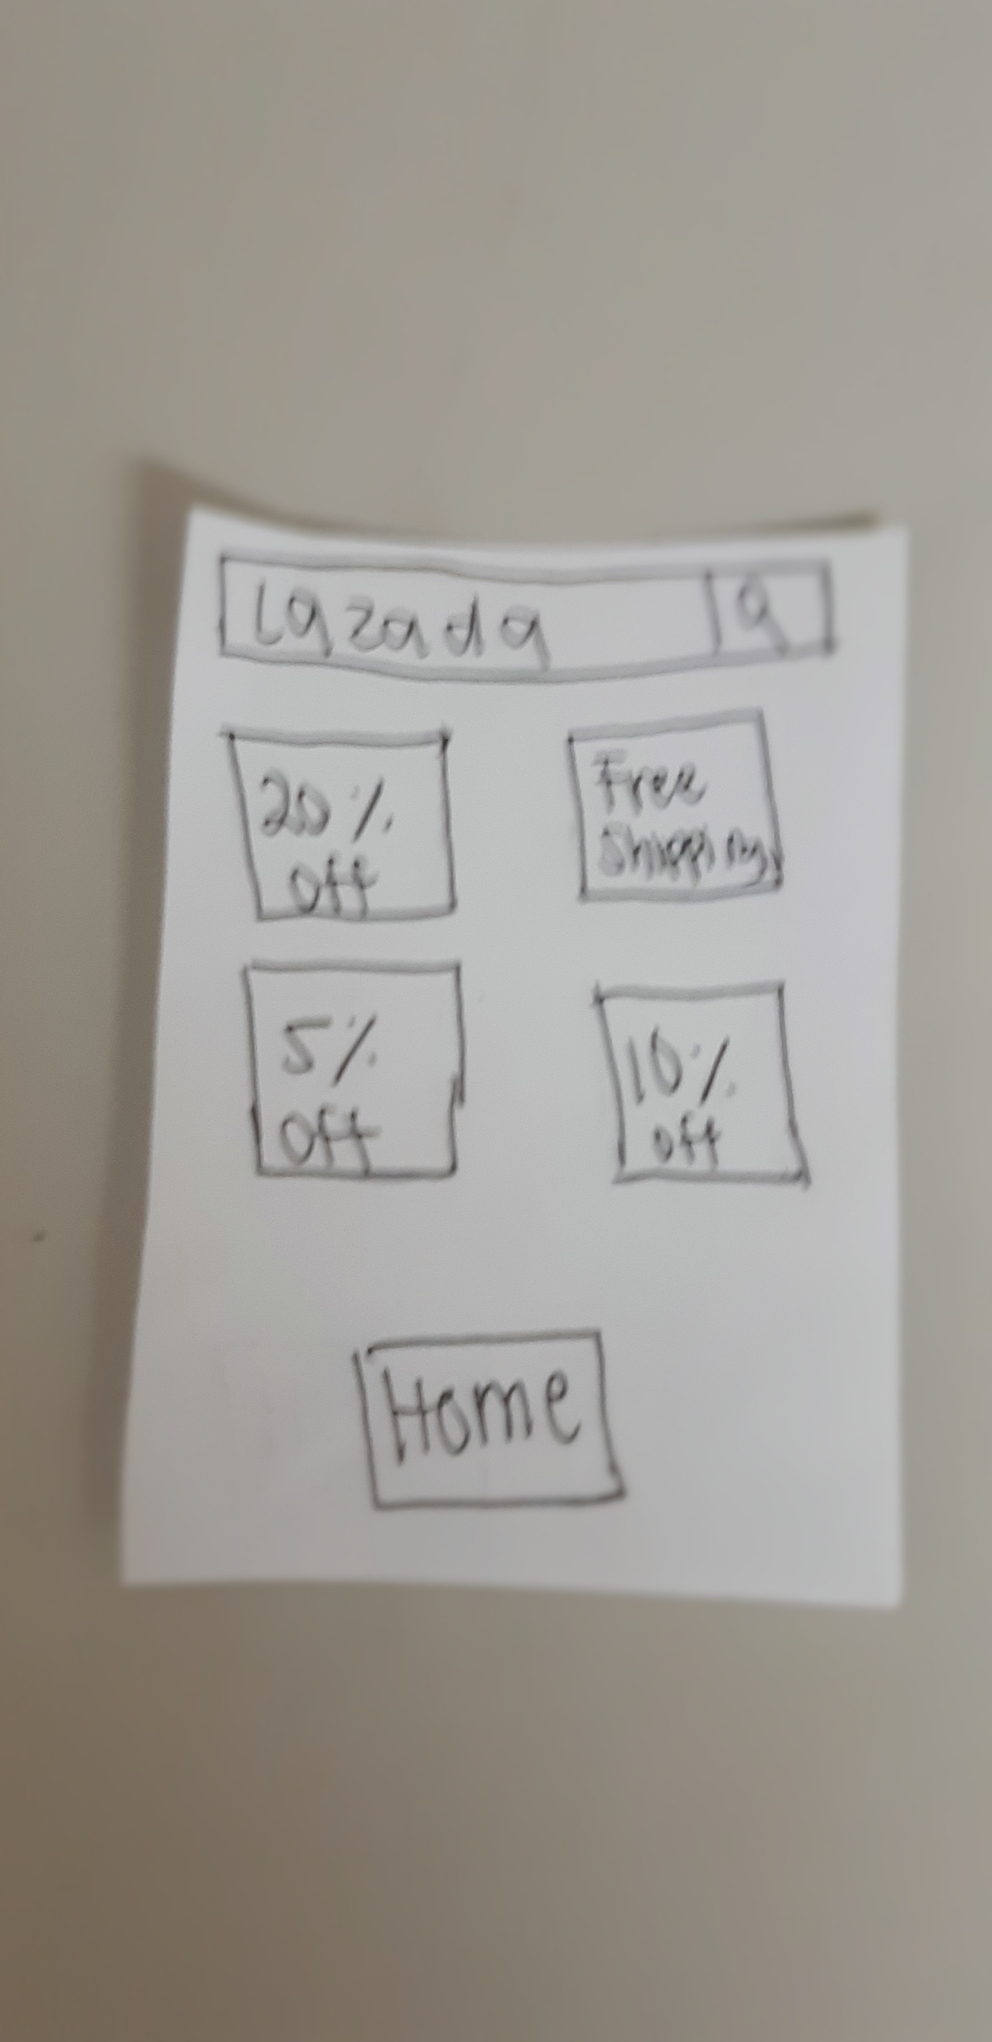
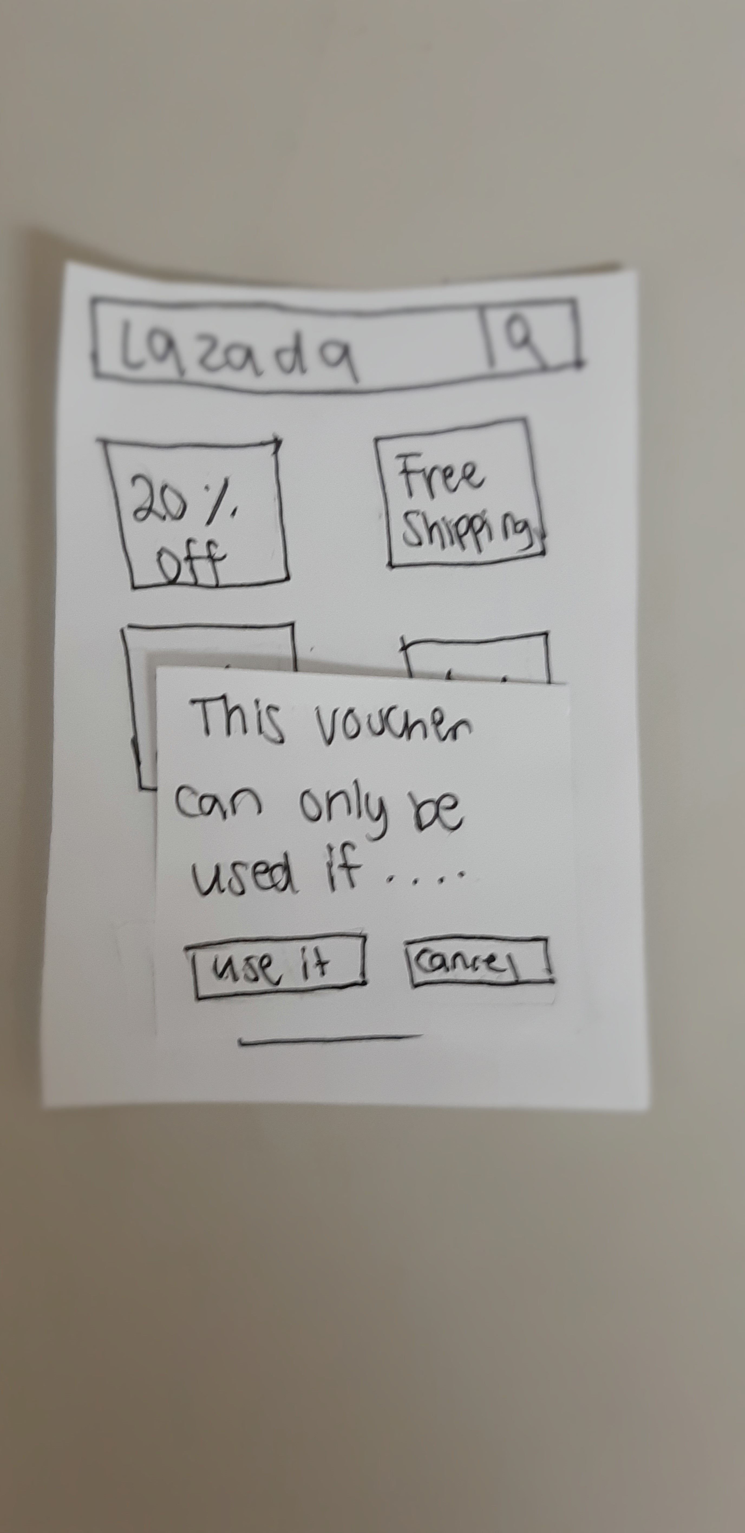
Paper Prototype 1

Slide 18
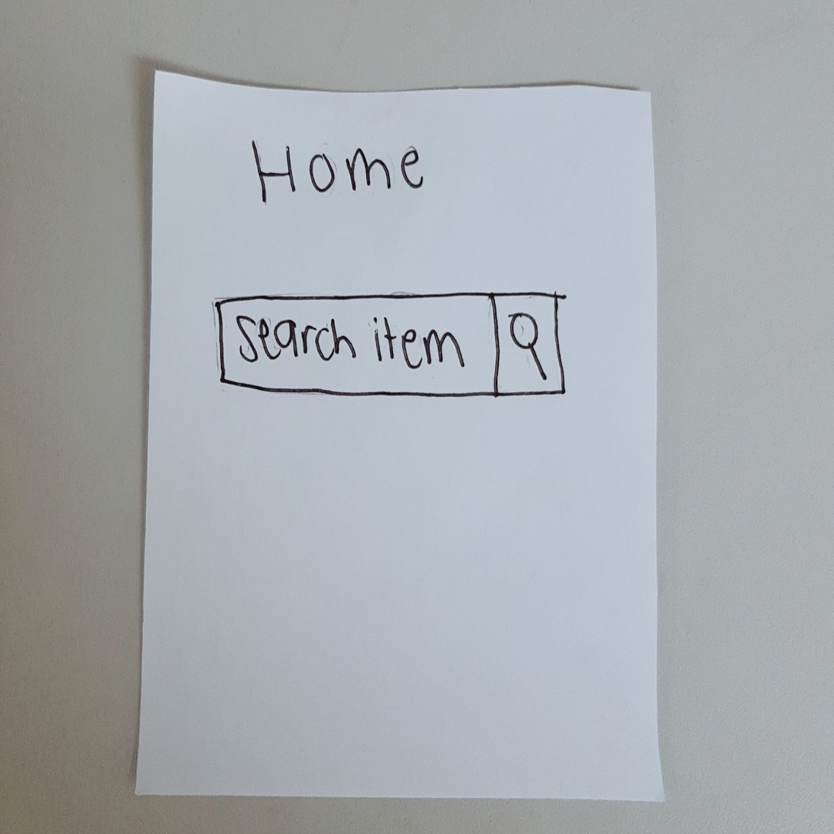
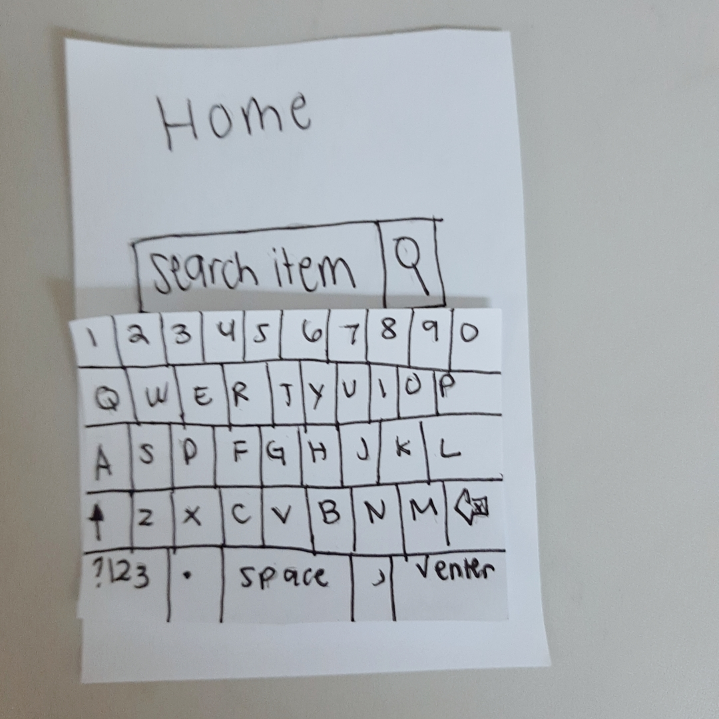
Paper Prototype 2

Slide 19
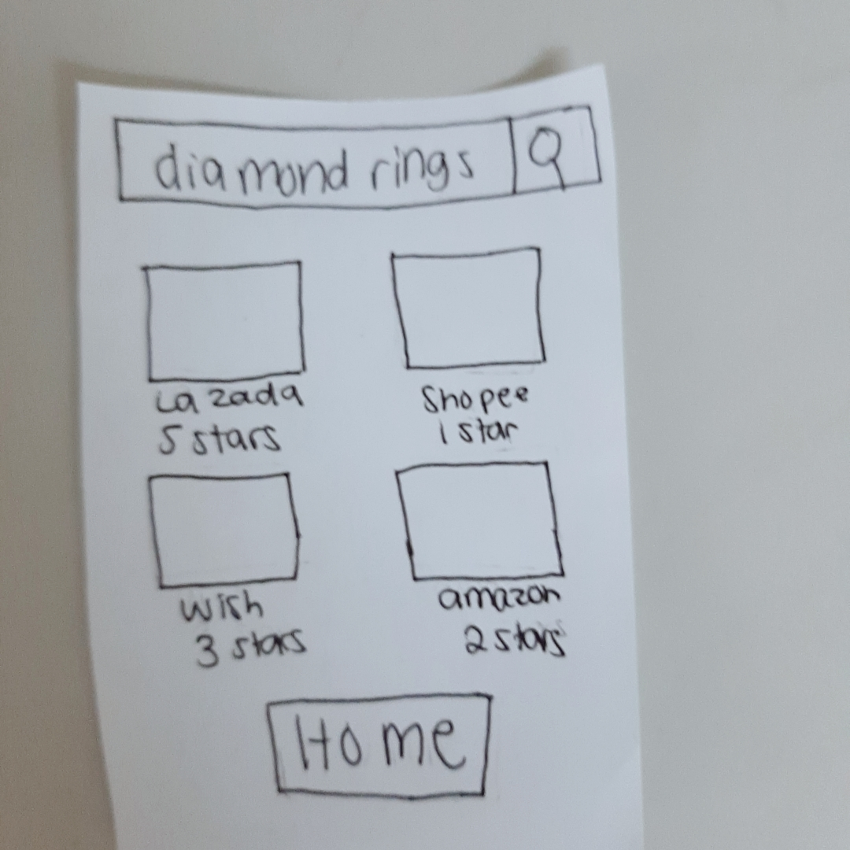
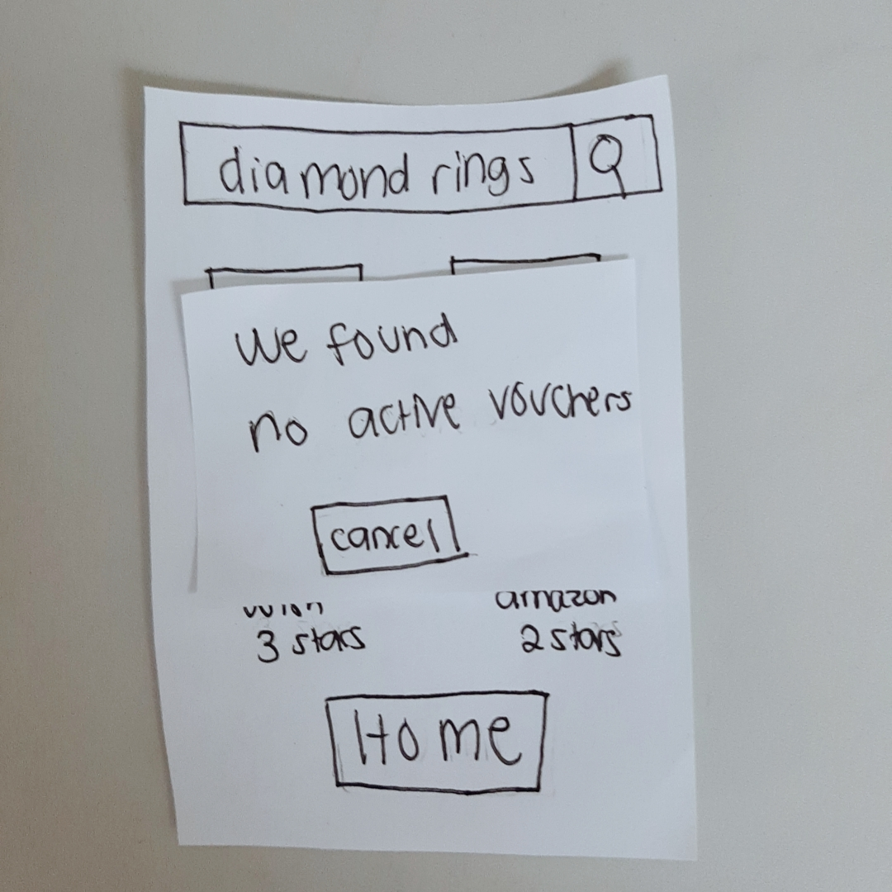
Paper Prototype 2

Slide 20
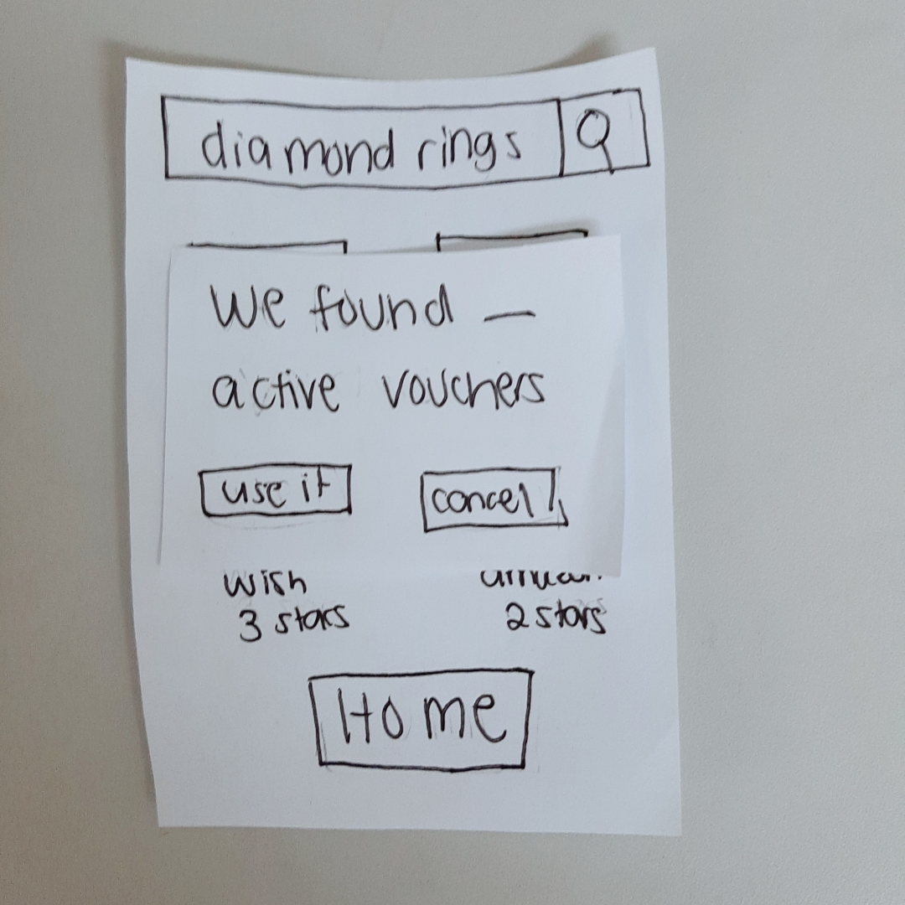
Paper Prototype 2

Slide 21
Recommendations and Remarks
Kean Coria – APC Student
Search items and search vouchers are in the links or buttons (one search bar)
Voucher options should be integrated to the store gallery

Slide 22
Recommendations and Remarks
Jaques Earnest Philip Ramos– APC Student
Needs a filter to arrange it by price, shop, or star rating/reviews.
Interface Is not confusing and straightforward, very easy to use.

